Slide 1

The Eyes Have It
A Task by Data Type Taxonomy for Information Visualizations
Louis Paulet, Karim Djedidi

Slide 2

Presentation Structure
Publication
About the author (1-2-3)
Research
Introduction
Visual Information Seeking Mantra
Task by data type taxonomy
Advanced Filtering
Summary
Conclusion
Sources

Slide 3
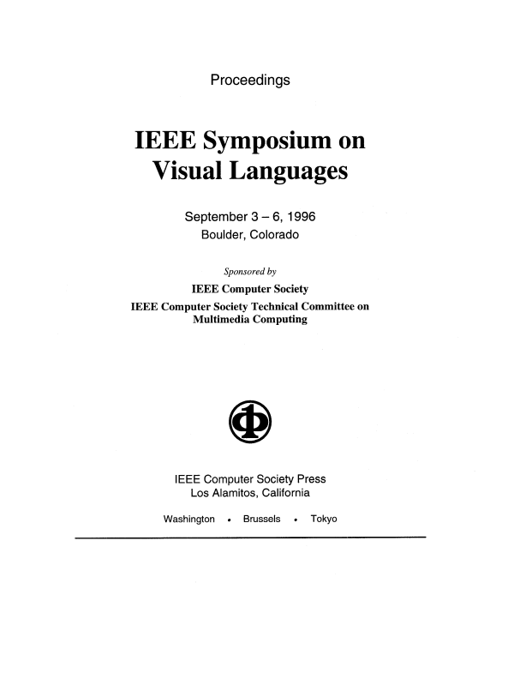
Publication
Title : The Eyes Have It: A Task by Data Type Taxonomy for Information Visualizations
Publication Venue : Published in 1996 proceedings IEEE Symposium on Visual Languages, Boulder, Colorado, US
Author : Ben Shneiderman

Slide 4

About the author (1)
Ben Shneiderman
Lots of awards, honorary doctorates all over the world (Canada, USA, Spain, UK, South Africa…)
Created the 8 golden rules of interface design
Founding director of Human-Computer Interaction Laboratory, and Institute for Systems Research University of Maryland (1983-2000)

Slide 5
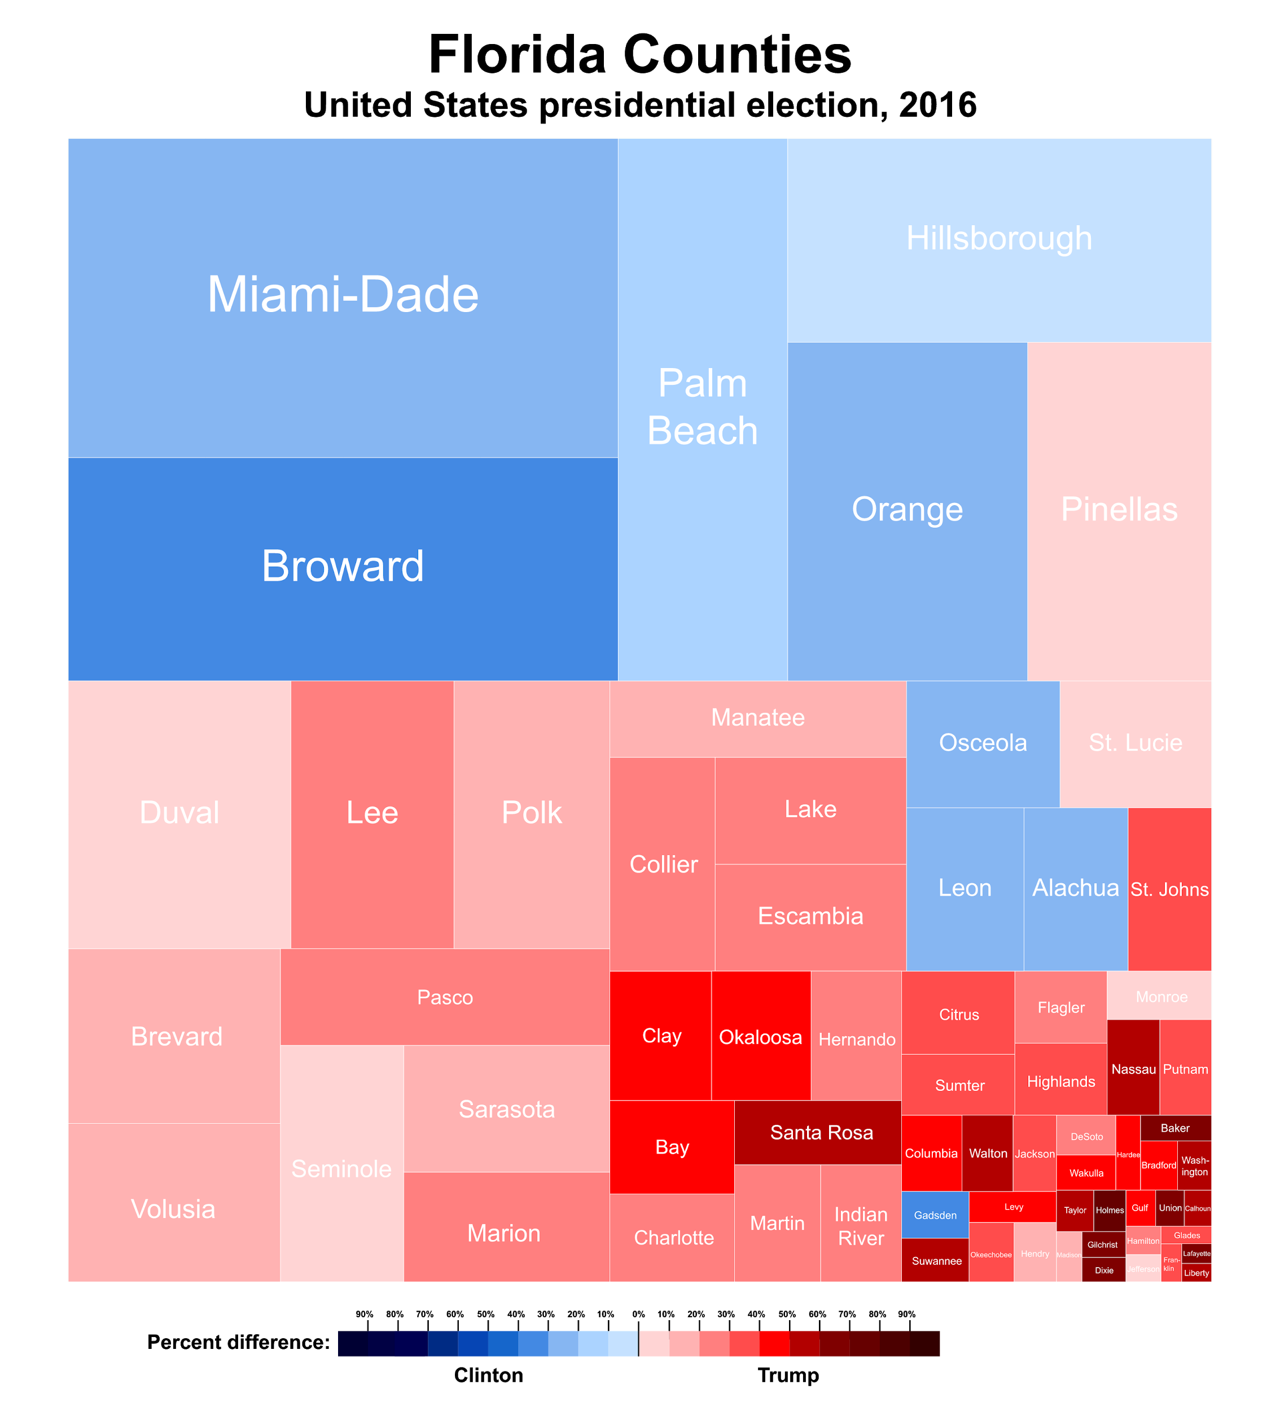
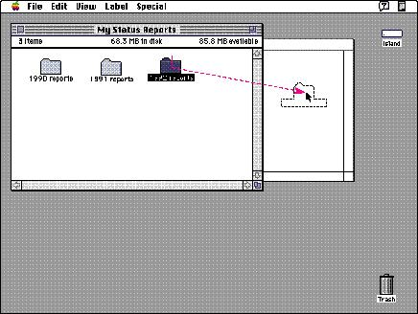
About the author (2)
Direct-manipulation interfaces
Treemap

Slide 6



About the author (3)
Lots of references in articles : http://www.cs.umd.edu/users/ben/publications.html
As of May 2020, following are Prof. Ben Shneiderman's articles in Refereed Journals(177), Refereed Conferences(157), Unrefereed Publications(97) and Chapters in Books(29).

Slide 7




Research
What question is the paper answering ?
Visual Information Mantra
Type by Task Taxonomy
What is a good data visualization software ?
Why is it important ?
DataViz software needs to be used by people not familiar with data
Lots of software getting created in 1996

Slide 8

Introduction
information overload
worse as data size increases
new technologies will save us

Slide 9
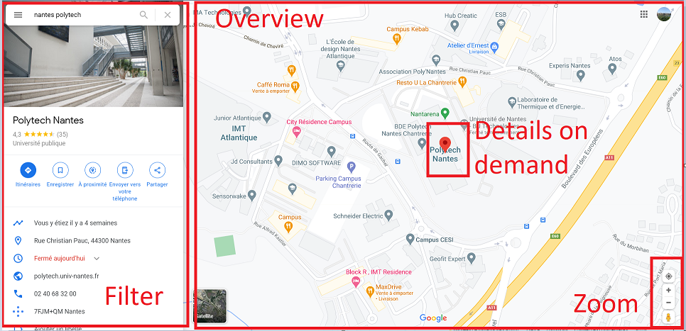
Visual information seeking mantra
“Overview first, zoom and filter, then details-on-demand”
Notes:
visual representation allows the recognition of patterns

Slide 10
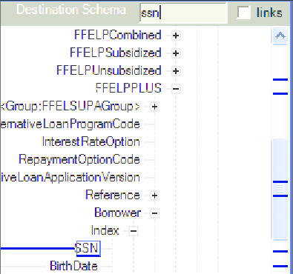
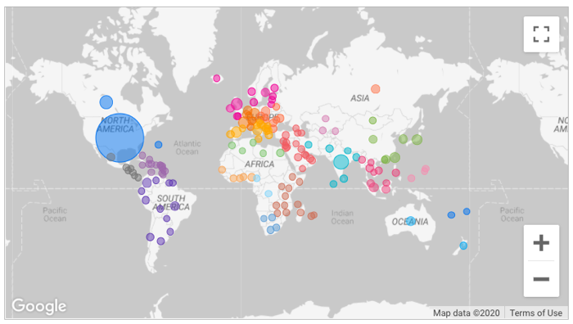
Task by data type taxonomy
1-dimensional: Linear data types
Textual documents / program source code / alphabetical lists of names
2-dimensional: Planar or map data
Geographic maps/ floorplans/ newspaper layouts

Slide 11
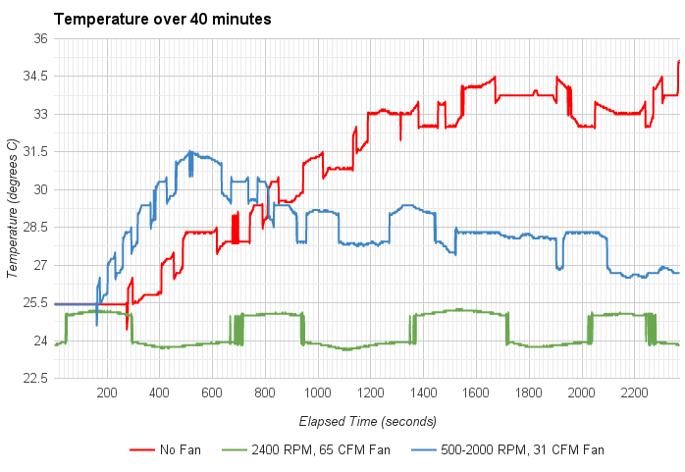
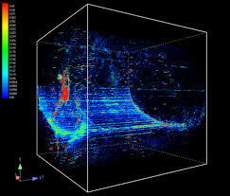
Task by data type taxonomy
3-dimensional: Real-world objects that have items with volume and some potentially complex relationship with other items
Molecules / the human body / buildings
Temporal: Items have a start and finish time and they may overlap.
LifeLines / Project management

Slide 12
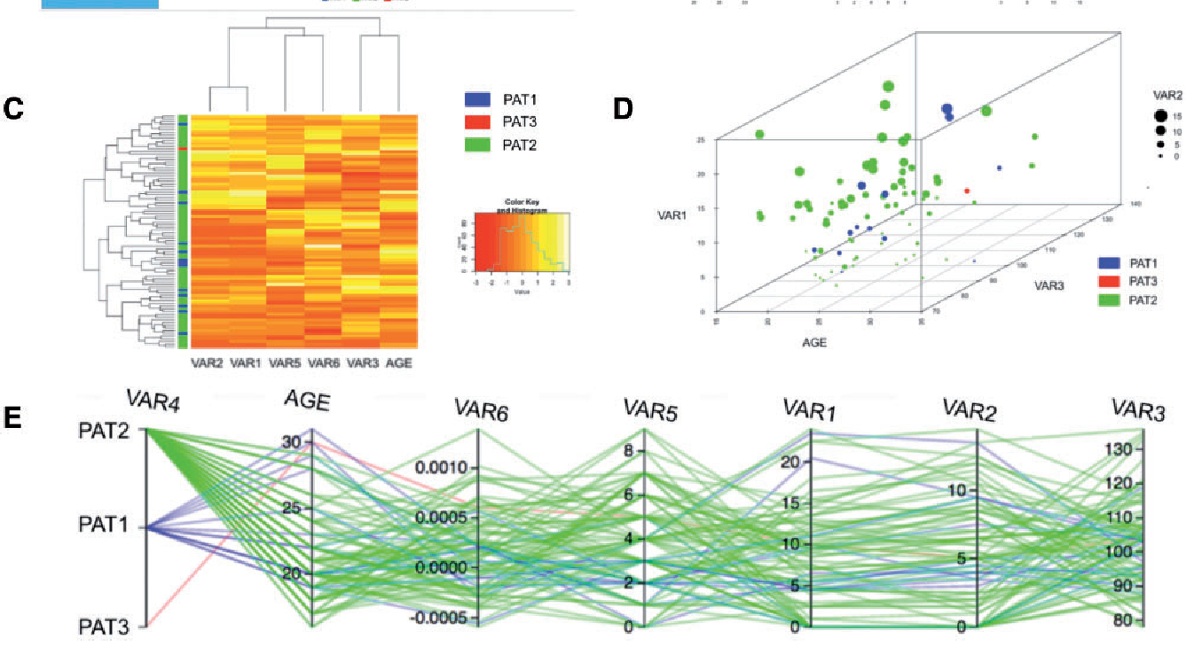
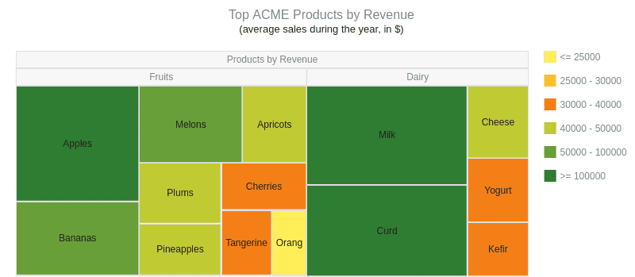
Task by data type taxonomy
Multi-dimensional: items with n attributes become points in a n-dimensional space
Most relational and statistical databases
Tree: Collections of items with each item having a link to one parent item (except the root)
Connecting lines as in many computer-directory file managers

Slide 13
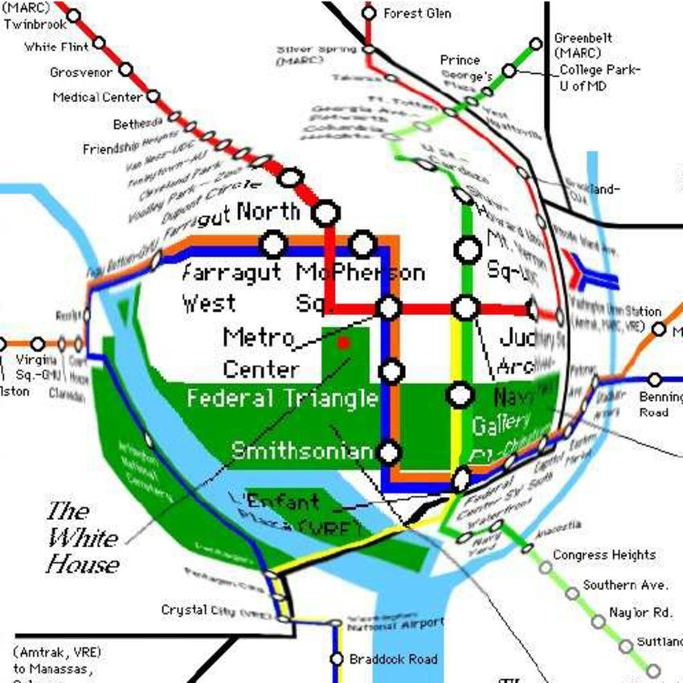
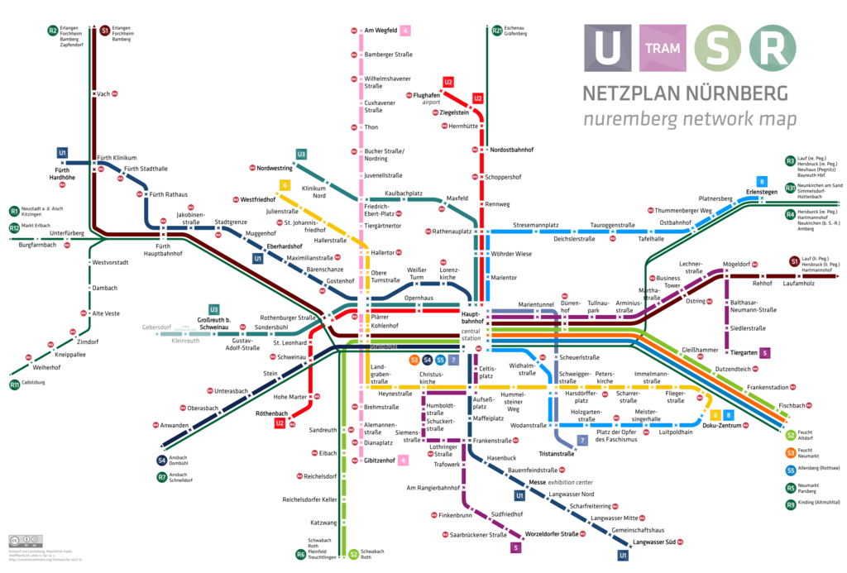
Task by data type taxonomy
Network: Many special cases of networks exist (acyclic, lattices, rooted vs. un-rooted, directed vs. undirected)
Commercial packages can handle small networks or simple strategies such as Netmap's layout of nodes on a circle with links criss-crossing the central area
Overview: Gain an overview to see the entire collection plus adjoining detail view.

Slide 14




Task by data type taxonomy
Zoom: Zoom in on some proportion of the collection that have interest in. Smooth zooming helps users preserve their sense of position and context.
Filter: Focus on the interesting items by eliminating unwanted items.
Details on demand: Select an item or group and get details when needed.
Relate: View relationships among items.

Slide 15


Task by data type taxonomy
History: Keep a history of actions to support undo, replay, and progressive refinement. Information exploration is inherently a process with many steps, so keeping the history of actions and allowing users to retrace their steps is important
Extract: Allow extraction of sub-collections and of the query parameters. It would be useful to be able to extract that set and save it to a file in a format that would facilitate other uses

Slide 16
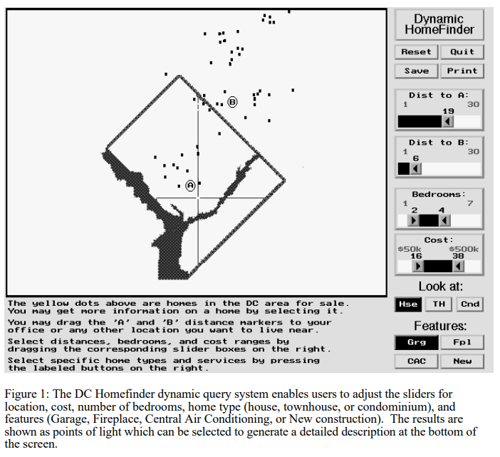
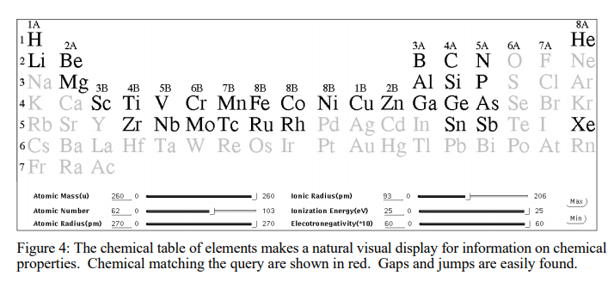
Advanced Filtering (1)
Dynamic Filtering

Slide 17
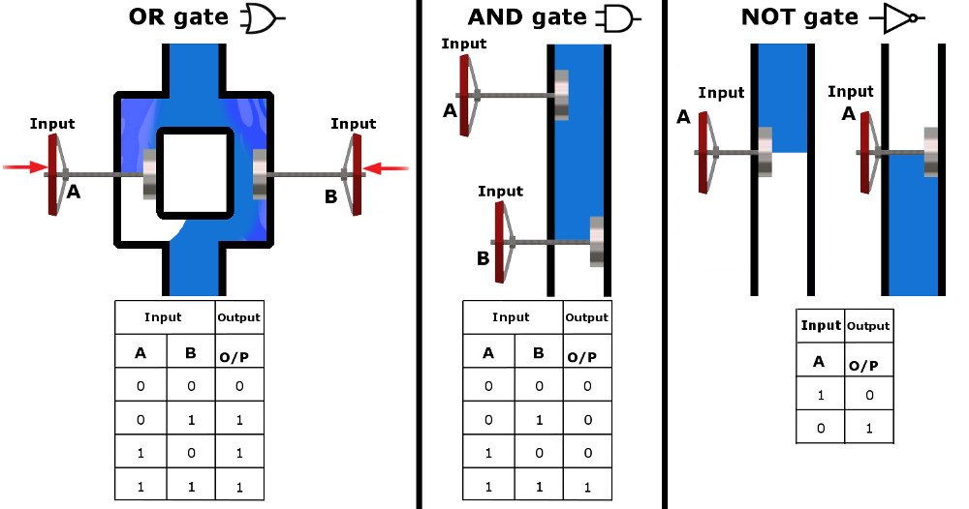
Advanced Filtering (2)
specific question answering
boolean logic vs natural language
visualization with water pipes

Slide 18
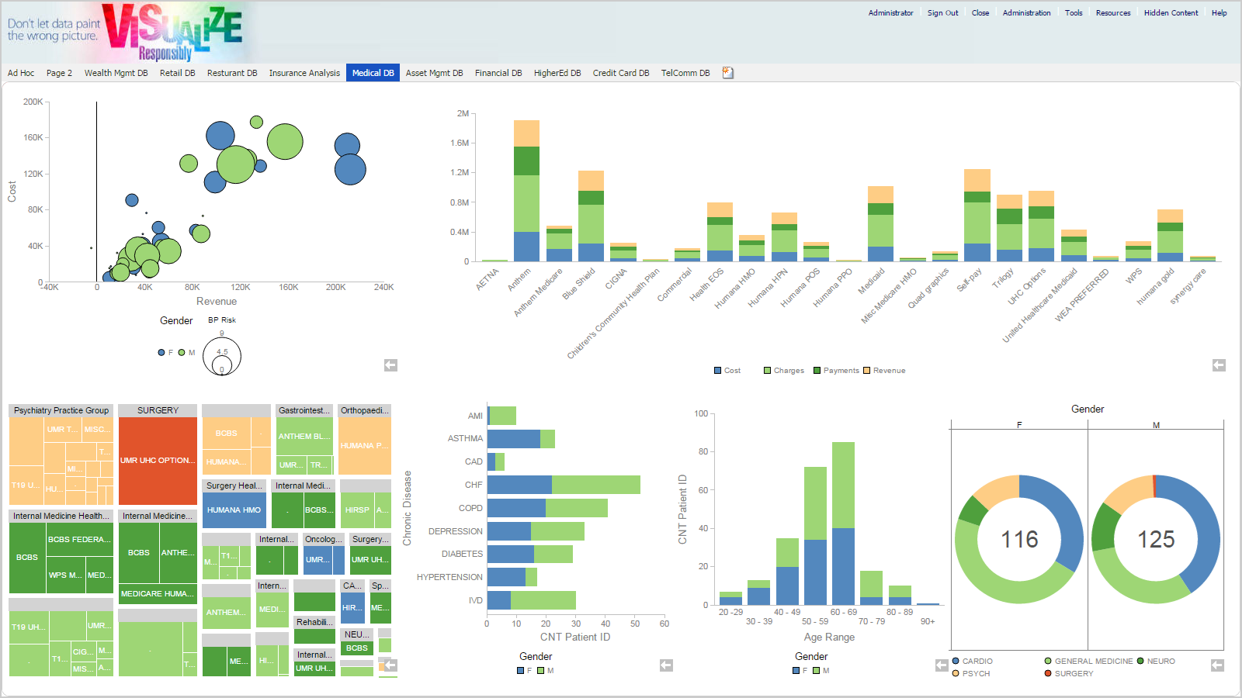
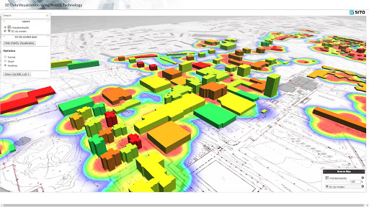
Summary
Dataviz software will have to include all data types and tasks
Basic tasks allow more users to use the products
Advanced tasks will be needed (like advanced filtering) to get precise answers

Slide 19
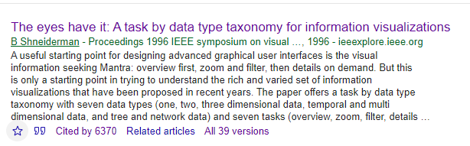
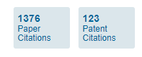
Conclusion
The paper contains a list of tasks and data types, enriched with studies.
Ben Shneiderman gives advice to build better data visualisation thanks to the visual information seeking mantra, the type by task taxonomy (TTT), and suggestions for a better advanced filtering.
The eyes have it is cited in hundreds of patents

Slide 20
Sources (1)
Ben Shneiderman University of Maryland page
Ben Shneiderman latest books :
Shneiderman, B., Twin-Win Research: Your Guidebook for Accelerating Campus Discovery and Innovation: Second Edition, Morgan & Claypool (2019)
Shneiderman, B., Rock the Research: Your Guidebook for Accelerating Campus Discovery and Innovation, Amazon Kindle & Paperback (January 2018)
Designing the User Interface: Strategies for Effective Human-Computer Interaction: Sixth Edition, Pearson (May 2016)
Latest references : Publications of Ben Shneiderman
Ben Shneiderman Google Scholar Page
Ben Schneiderman LinkedIn Page
Google Scholar link to the article "The eyes have it"
Video about the bifocal display : Bifocal Display Concept Video from 1982

Slide 21
Sources (2)
Dynamic Queries for Visual Information Seeking (Ben Schneiderman, 1994)
2-dimensional : exploratory access to geographic data based on the map overlay metaphor

